Slide 1

Cloud & Azure Fundamentals

Slide 2

Introduction to Cloud Computing
Cloud computing is the delivery of computing resources as a service, meaning that the resources are owned and managed by the cloud provider rather than the end user. Those resources may include anything from browser-based software applications (such as TikTok or Netflix), third party data storage for photos and other digital media (such as iCloud or Drop box), or third-party servers used to support the computing infrastructure of a business, research, or personal project.
According to National Institute of Standards and Technology, US Department of Commerce, cloud computing can be defined as “a model for enabling ubiquitous, convenient, on-demand network access to a shared pool of configurable computing resources (e.g., networks, servers, storage, applications, and services) that can be rapidly provisioned and released with minimal management effort or service provider interaction”.

Slide 3
Characteristics of Cloud Computing
The five essential characteristics of cloud computing are:
On-demand self-service: Cloud resources can be accessed or provisioned without human interaction. With this model, consumers can gain immediate access to cloud services upon signup. Organizations can also create mechanisms for allowing employees, customers, or partners to access internal cloud services on demand according to predetermined logics without needing to go through IT services.
Broad network access: Users can access cloud services and resources through any device and in any networked location provided that they have permission.
Resource pooling: Cloud provider resources are shared by multiple tenants while keeping the data of individual clients hidden from other clients.
Rapid elasticity: Unlike on-premise hardware and software, cloud computing resources can be rapidly increased, decreased, or otherwise modified based on the cloud user’s changing needs.
Measured service: Usage of cloud resources is metered so that businesses and other cloud users need only pay for the resources they use in any given billing cycle.

Slide 4
Cloud Computing
The architecture of cloud computing comprises of the following components −
Front-end Devices − These are basically the devices that are used by clients to access the data or program using the browser or special applications.
Back-end Platform − There are various computers, servers, virtual machines, etc. that combine to become a back-end platform.
Cloud-based delivery Network
Benefits of using Cloud
Cloud service offers scalability. Allocation and de-allocation of resources is dynamically done as per demand.
It saves on cost by reducing capital infrastructure.
It allows the user to access the application independent of their location and hardware configuration.
It simplifies the network and lets the client access the application without buying license for individual machine.
Storing data on clouds is more reliable as it is not lost easily.

Slide 5
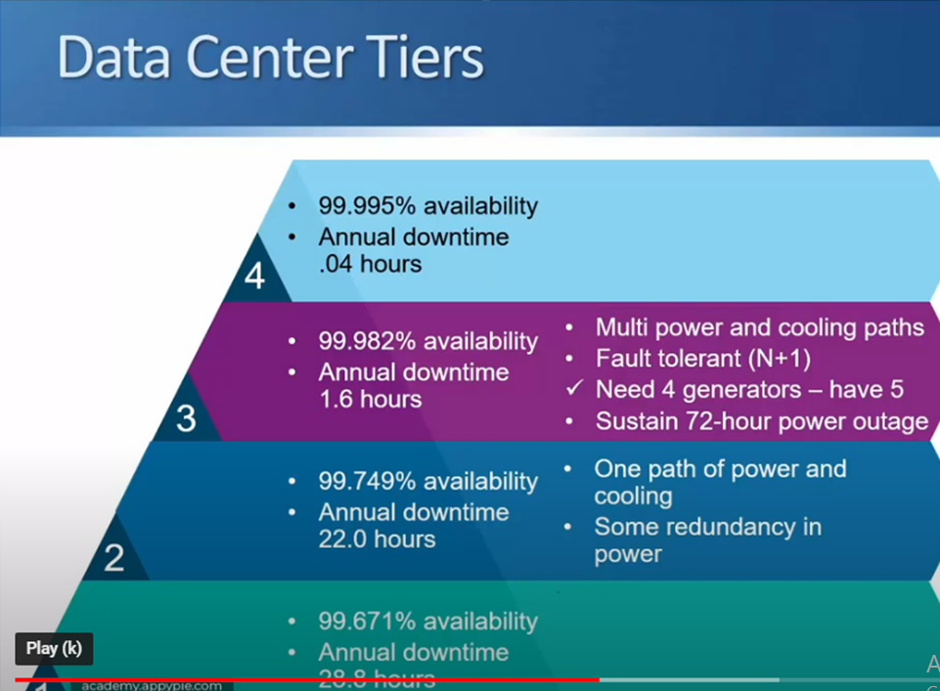
Data Center Tier 1

Slide 6

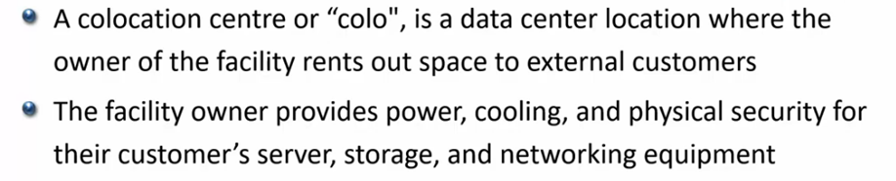
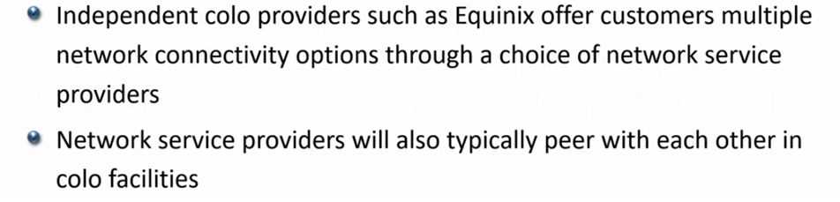
Traditional IT Deployment Model before Cloud Computing

Slide 7
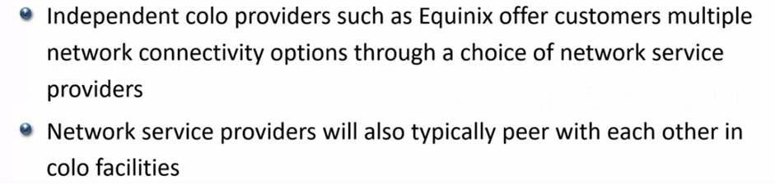
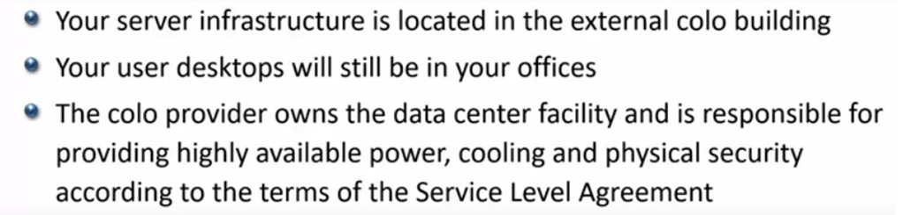
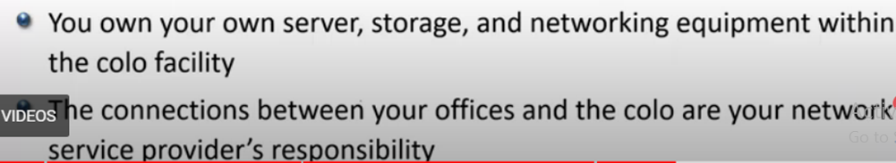

Slide 8
Virtualization in Cloud Computing
“Virtualization” refers to the process of making a “virtual version” of hardware or software like - virtual servers, infrastructure, devices and computing resources. For example, creating a virtual machine that serves as a real-life computer.
Consider an instance, a user can take a computer running on Windows as an operating system, then make a virtual machine over that computer, and then run another operating system on virtual machines like Linux.
Virtualization introduces the new significant connection between hardware-software and is one of the foundational portions of cloud computing technology.

Slide 9

Virtualization in Cloud Computing
Virtualization enables users to disjoint operating systems from the underlying hardware, i.e., users can run multiple operating systems such as Windows, Linux, on a single physical machine at the same time. Such operating systems are known as guest OSes (operating systems).
Virtualization deploys software that makes an abstraction layer across computer hardware, letting the hardware components such as processors, memory, storage etc. of a particular computer to be segmented into several virtual elements (also known as virtual machines).

Slide 10
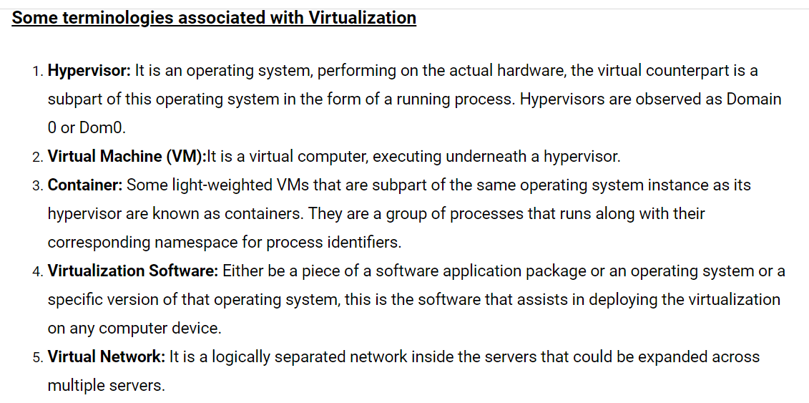
Virtualization in Cloud Computing

Slide 11
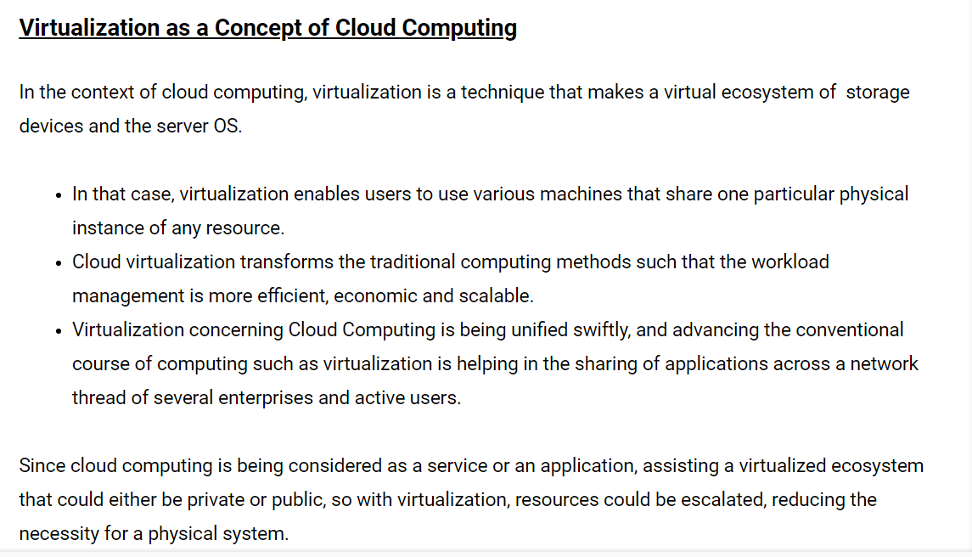
Virtualization in Cloud Computing

Slide 12
RDB
RDB is a full-featured, relational database management system for mission-critical applications on OpenVMS platforms. RDB became part of Oracle Corporation in 1994.
Since then, Oracle has made significant enhancements focused on supporting large scale production applications and high performance transaction processing.
Oracle RDB Product Family Releases are built to run on HP OpenVMS Itanium and Alpha Server Systems. 7.4 is the latest release of the Oracle RDB Product Family.
Oracle RDB's technical strengths include:
- Very high performance to deliver extraordinary real-world throughput
- Extremely high reliability, providing both data security and database uptime
- Extremely high availability—requirements for scheduled maintenance downtime are minimal
- Easy maintainability
- Low cost per transaction

Slide 13
What is Cloud Computing?
Cloud Computing is defined as storing and accessing of data and computing services over the internet. It doesn’t store any data on your personal computer. It is the on-demand availability of computer services like servers, data storage, networking, databases, etc. The main purpose of cloud computing is to give access to data centers to many users. Users can also access data from a remote server.
Examples of Cloud Computing Services: AWS, Azure, Google

Slide 14
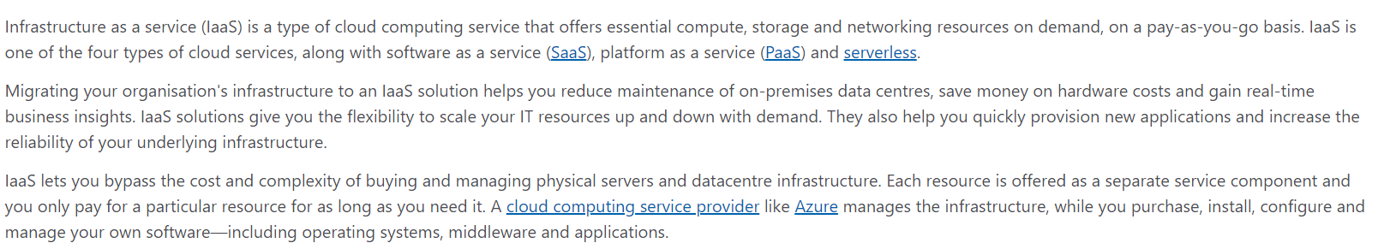
Services in Cloud Computing
The three major services in cloud computing are IaaS, PaaS and SaaS.

Slide 15
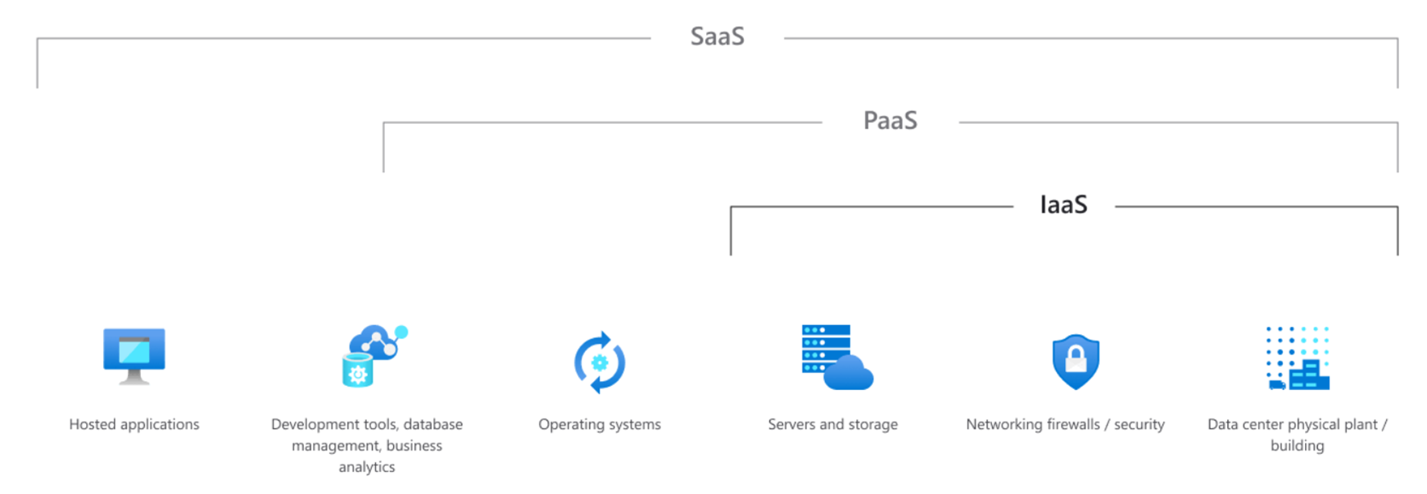
Services in Cloud Computing

Slide 16
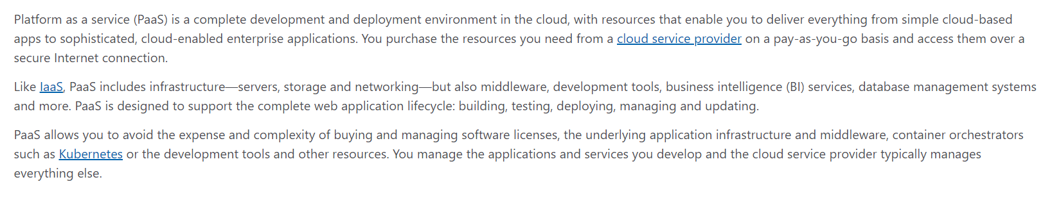
Services in Cloud Computing

Slide 17
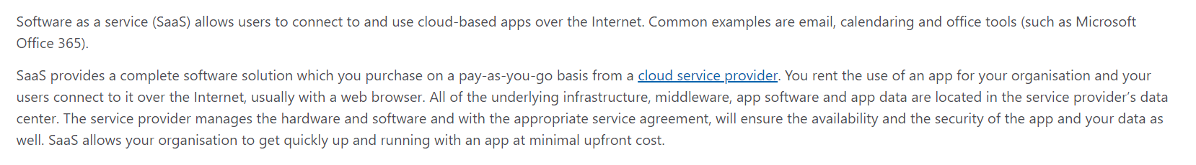
Services in Cloud Computing

Slide 18
Cloud Computing
Types of Cloud Storage options --
Public Cloud − A service provider makes the clouds available to the general public which is termed as a public cloud. These clouds are accessed through internet by users. These clouds are open to public and their infrastructure is owned and operated by service providers as in case of Google and Microsoft.
Private Cloud − These clouds are dedicated to a particular organization. That particular organization can use the cloud for storing the company's data, hosting business application, etc. The data stored on private cloud can't be shared with other organizations. The cloud is managed either by the organization itself or by the third party.
Hybrid Cloud − When two or more clouds are bound together to offer the advantage of both public and private clouds, they are termed as Hybrid Cloud. Organizations can use private clouds for sensitive application, while public clouds for non-sensitive applications. The hybrid clouds provide flexible, scalable and cost-effective solutions to the organizations.

Slide 19
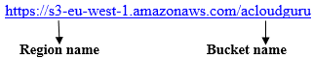
Storage(S3 bucket) in Cloud Computing
S3(Simple Storage Service) is one of the first services that has been produced by AWS.
S3 provides developers and IT teams with secure, durable, highly scalable object storage.
It is easy to use with a simple web services interface to store and retrieve any amount of data from anywhere on the web.
It is Object-based storage, that allows us to store the images, word files, pdf files, etc.
The files which are stored in S3 can be from 0 Bytes to 5 TB.
Files are stored in Bucket. A bucket is like a folder available in S3 that stores the files.
S3 is a universal namespace, i.e., the names must be unique globally. Bucket contains a DNS address. Therefore, the bucket must contain a unique name to generate a unique DNS address.
If we create a bucket, URL look like:
If we upload a file to S3 bucket, then we will receive an HTTP 200 code means that the uploading of a file is successful.

Slide 20
Advantages of Amazon S3
Create Buckets: Firstly, we create a bucket and provide a name to the bucket. Buckets are the containers in S3 that stores the data. Buckets must have a unique name to generate a unique DNS address.
Storing data in buckets: Bucket can be used to store an infinite amount of data. We can upload the files as much we want into an Amazon S3 bucket, i.e., there is no maximum limit to store the files. Each object can contain upto 5 TB of data. Each object can be stored and retrieved by using a unique developer assigned-key.
Download data: We can also download our data at any time from a bucket and can also give permission to others to download the same data.
Permissions: We can also grant or deny access to others who want to download or upload the data from our Amazon S3 bucket. Authentication mechanism keeps the data secure from unauthorized access.
Standard interfaces: S3 is used with the standard interfaces REST and SOAP interfaces which are designed in such a way that they can work with any development toolkit.
Security: Amazon S3 offers security features by protecting unauthorized users from accessing our data.

Slide 21
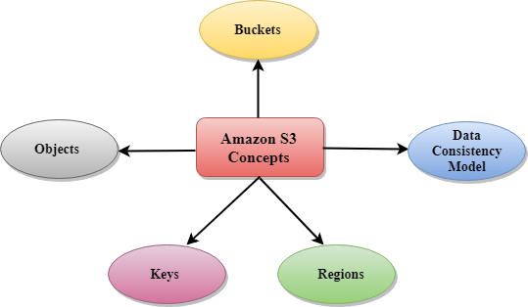
Amazon S3 Concepts

Slide 22
Amazon S3 Concepts
Buckets
A bucket is a container used for storing the objects.
Every object is incorporated in a bucket.
For example, if the object named photos/tree.jpg is stored in the treeimage bucket, then it can be addressed by using the URL http://treeimage.s3.amazonaws.com/photos/tree.jpg.
A bucket has no limit to the amount of objects that it can store. No bucket can exist inside of other buckets.
S3 performance remains the same regardless of how many buckets have been created.
The AWS user that creates a bucket owns it, and no other AWS user cannot own it. Therefore, we can say that the ownership of a bucket is not transferrable.
The AWS account that creates a bucket can delete a bucket, but no other AWS user can delete the bucket.

Slide 23
Amazon S3 Concepts
Objects
Objects are the entities which are stored in an S3 bucket.
An object consists of object data and metadata where metadata is a set of name-value pair that describes the data.
An object consists of some default metadata such as date last modified, and standard HTTP metadata, such as Content type. Custom metadata can also be specified at the time of storing an object.
It is uniquely identified within a bucket by key and version ID.
Key
A key is a unique identifier for an object.
Every object in a bucket is associated with one key.
An object can be uniquely identified by using a combination of bucket name, the key, and optionally version ID.
For example, in the URL http://jtp.s3.amazonaws.com/2019-01-31/Amazons3.wsdl where "jtp" is the bucket name, and key is "2019-01-31/Amazons3.wsdl“
Regions
We can choose a geographical region in which we want to store the buckets that we have created.
A region is chosen in such a way that it optimizes the latency, minimize costs or address regulatory requirements.
Objects will not leave the region unless we explicitly transfer the objects to another region.

Slide 24
Amazon Relational Database Service
Amazon RDS (Relational Database Service) is a fully-managed SQL database cloud service that allows us to create and operate relational databases. Using RDS we can access our files and database anywhere in a cost-effective and highly scalable way.
Features of Amazon RDS
Scalable − Amazon RDS allows to scale the relational database by using AWS Management Console or RDS-specific API. We can increase or decrease our RDS requirements within minutes.
Host replacement − Sometimes these situations occur when the hardware of Amazon RDS fails. There is no need to worry, it will be automatically replaced by Amazon.
Inexpensive − Using Amazon RDS, we pay only for the resources we consume. There is no up-front and long-term commitment.
Secure − Amazon RDS provides complete control over the network to access their database and their associated services.
Automatic backups − Amazon RDS backs up everything in the database including transaction logs up to last five minutes and also manages automatic backup timings.
Software patching − Automatically gets all the latest patches for the database software. We can also specify when the software should be patched using DB Engine Version Management.

Slide 25
Microsoft Azure
Windows Azure is the cloud computing platform as provided by Microsoft. Azure can be described as the managed data centers that are used to build, deploy, manage the applications and provide services through a global network.
The services provided by Microsoft Azure are PaaS and IaaS. Many programming languages and frameworks are supported by it.
Azure as PaaS (Platform as a Service)
As the name suggests, a platform is provided to clients to develop and deploy software. The clients can focus on the application development rather than having to worry about hardware and infrastructure. It also takes care of most of the operating systems, servers and networking issues.
Azure as IaaS (Infrastructure as a Service)
It is a managed cloud service that gives complete control of the operating systems and the application platform stack to the application developers. It lets the user to access, manage and monitor the data centers by themselves.

Slide 26
Microsoft Azure
Azure as PaaS (Platform as a Service)
Pros
The overall cost is low as the resources are allocated on demand and servers are automatically updated.
It is less vulnerable as servers are automatically updated and being checked for all known security issues. The whole process is not visible to developer and thus does not pose a risk of data breach.
Since new versions of development tools are tested by the Azure team, it becomes easy for developers to move on to new tools. This also helps the developers to meet the customer’s demand by quickly adapting to new versions.
Cons
There are portability issues with using PaaS. There can be a different environment at Azure, thus the application might have to be adapted accordingly.

Slide 27
Microsoft Azure
Azure as IaaS (Infrastructure as a Service)
Pros
This is ideal for the application where complete control is required. The virtual machine can be completely adapted to the requirements of the organization or business.
IaaS facilitates very efficient design time portability. This means application can be migrated to Windows Azure without rework. All the application dependencies such as database can also be migrated to Azure.
IaaS allows quick transition of services to clouds, which helps the vendors to offer services to their clients easily. This also helps the vendors to expand their business by selling the existing software or services in new markets.
Cons
Since users are given complete control they are tempted to stick to a particular version for the dependencies of applications. It might become difficult for them to migrate the application to future versions.
There are many factors which increases the cost of its operation. For example, higher server maintenance for patching and upgrading software.
There are lots of security risks from unpatched servers. Some companies have welldefined processes for testing and updating on-premise servers for security vulnerabilities. These processes need to be extended to the cloud-hosted IaaS VMs to mitigate hacking risks.
The unpatched servers pose a great security risk. Unlike PaaS, there is no provision of automatic server patching in IaaS. An unpatched server with sensitive information can be very vulnerable affecting the entire business of an organization.
It is difficult to maintain legacy apps in Iaas. It can be stuck with the older version of the operating systems and application stacks. Thus, resulting in applications that are difficult to maintain and add new functionality over the period of time.

Slide 28
Microsoft Azure Portal
Azure Management Portal is an interface to manage the services and infrastructure launched in 2012. All the services and applications are displayed in it and it lets the user manage them.
Getting started
A free trial account can be created on Azure management portal by visiting the following link - manage.windowsazure.com
The screen that pops up is as shown in the following image. The account can be created using our existing outlook account.
Sign In To Azure
Once logged in, you will be redirected to the screen, where there is a list of services and applications on the left panel.
Azure Management Portal
When you click on a category, its details are displayed on the screen. You can see the number of applications, virtual machine, mobile services and so on by clicking on the menu item.

Slide 29
Azure Content Delivery Network (CDN)
The Azure Content Delivery Network (CDN) caches Azure blobs and static content used by cloud services at strategically placed locations to provide maximum bandwidth for delivering content to users.
If you are an existing CDN customer, you can now manage your CDN endpoints through the Microsoft Azure Portal.
The CDN offers developers a global solution for delivering high-bandwidth content by caching the content at physical nodes across the world. For a current list of CDN node locations, see Azure Content Delivery Network (CDN) POP Locations.
The benefits of using the CDN to cache Azure data include:
Better performance and user experience for end users who are far from a content source, and are using applications where many "internet trips" are required to load content
Large distributed scale to better handle instantaneous high load, like at the start of a product launch event.
When you create or enable a CDN endpoint, it may take up to 90 minutes to propagate worldwide.
When a request for an object is first made to the CDN, the object is retrieved directly from the object's source origin location. This origin can be an Azure storage account, web app, cloud service, or any custom origin that accepts public web requests. When a request is made using the CDN syntax, the request is redirected to the CDN endpoint closest to the location from which the request was made to provide access to the object. If the object is not found at that endpoint, then it is retrieved from the service and cached at the endpoint, where a time-to-live (TTL) setting is maintained for the cached object.

Slide 30
Azure Content Delivery Network (CDN)
Standard features
The Standard Azure CDN tier includes following features:
Easy integration with Azure services such as Storage, Web Apps, and Media Services
Query string caching
Custom domain name support
Country filtering
Core analytics
Custom content origins
HTTPS support
Load balancing
DDOS protection
Fast purge
Management via REST API
Premium features
The Premium CDN tier includes all of the features of the Standard tier, plus these additional features:
Customizable, rule-based content delivery engine
Advanced HTTP reports
Real-time stats

Slide 31
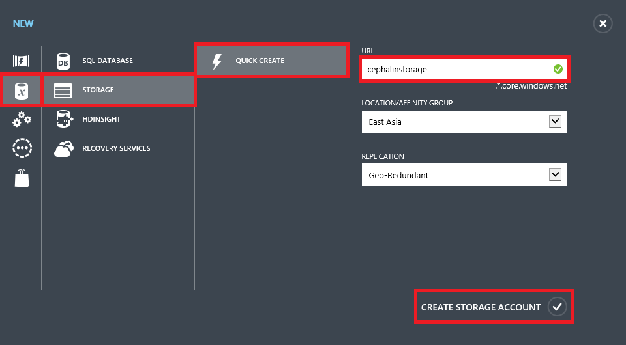
Serve Content from Azure CDN in Your Web Application
To create a CDN endpoint, log into your Azure management portal.
Create a storage account by clicking New > Data Services > Storage > Quick Create. Specify a URL, a location, and click Create Storage Account.

Slide 32
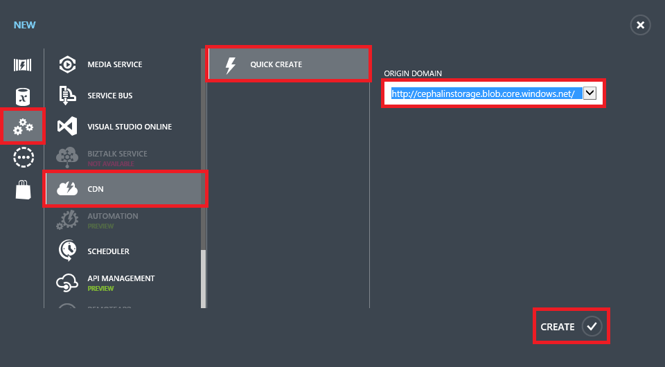
Serve Content from Azure CDN in Your Web Application
3. Once the new storage account's status is Online, create a new CDN endpoint that's tied to the storage account
you created. Click New > App Services > CDN > Quick Create. Select the storage account you created and click Create.

Slide 33
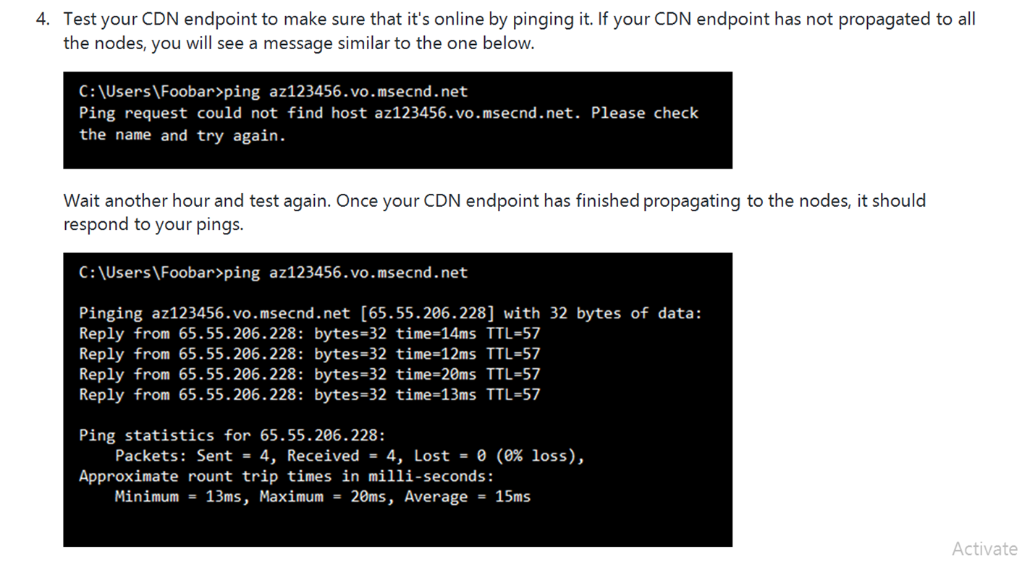
Serve Content from Azure CDN in Your Web Application

Slide 34
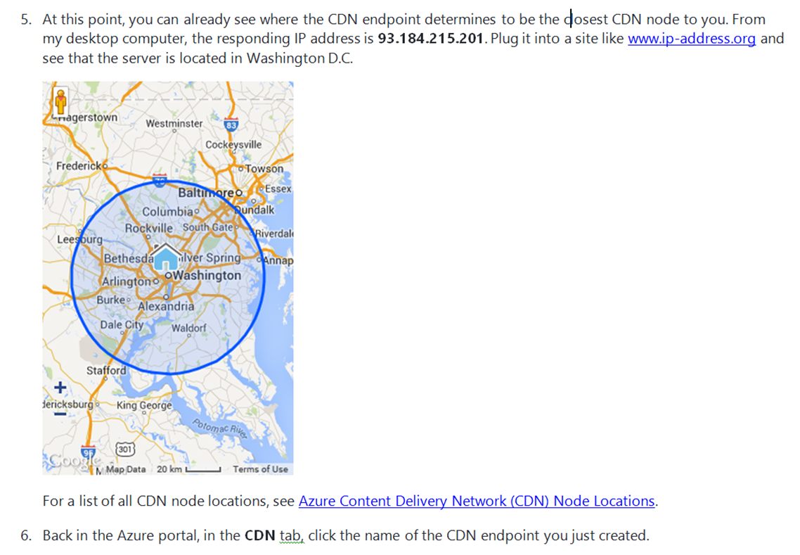
Serve Content from Azure CDN in Your Web Application

Slide 35
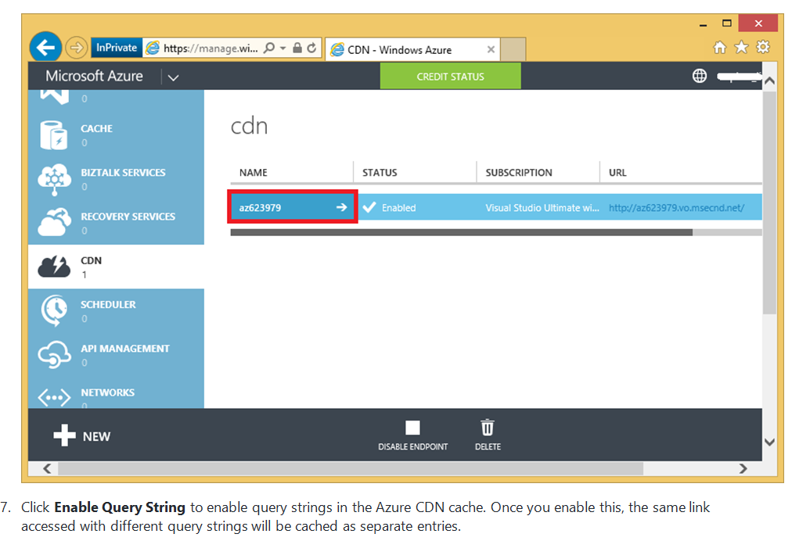
Serve Content from Azure CDN in Your Web Application

Slide 36
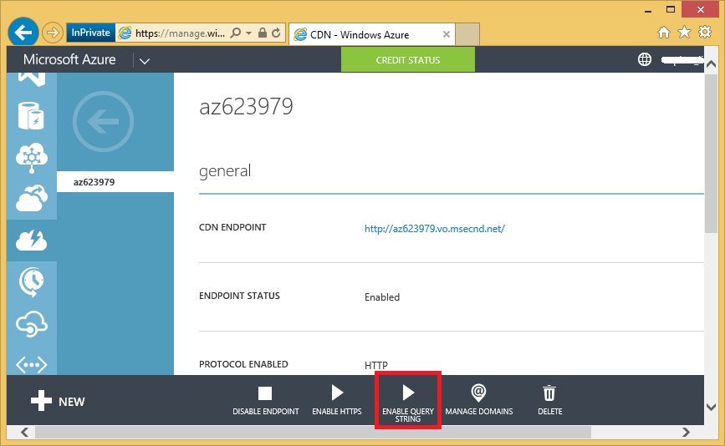
Serve Content from Azure CDN in Your Web Application

Slide 37
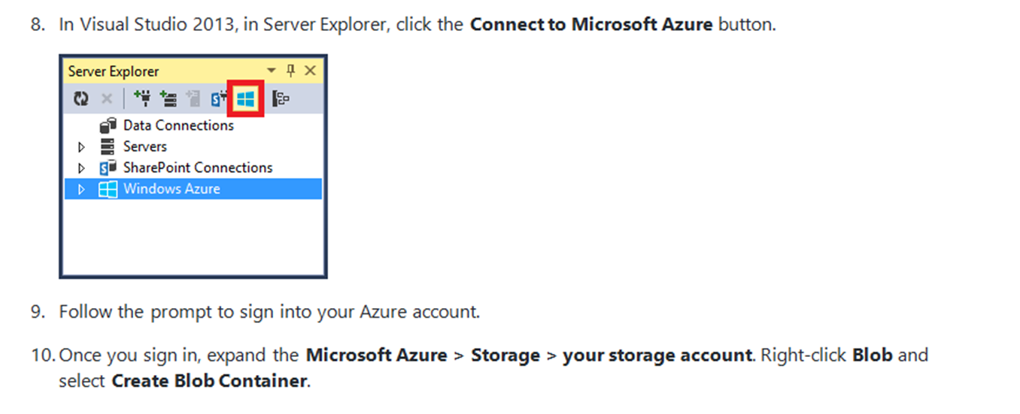
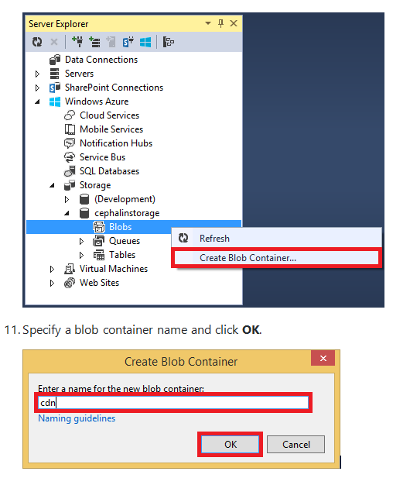
Serve Content from Azure CDN in Your Web Application

Slide 38
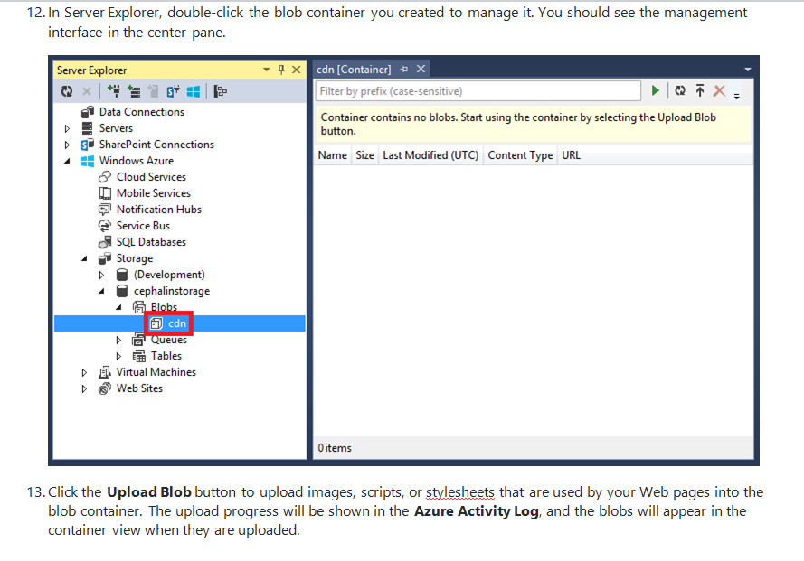
Serve Content from Azure CDN in Your Web Application

Slide 39
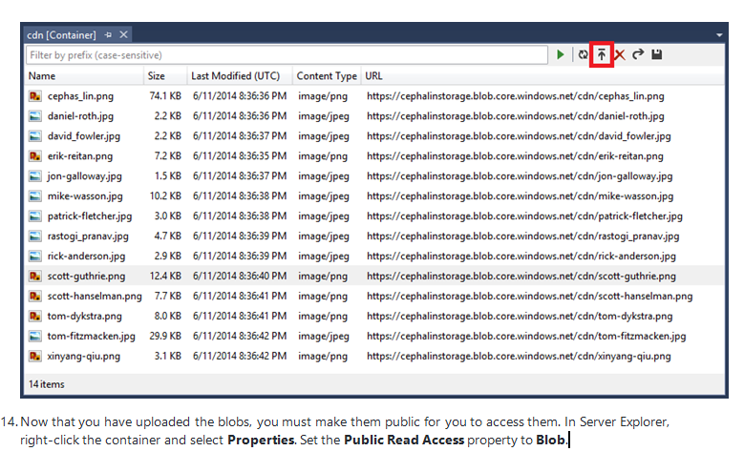
Serve Content from Azure CDN in Your Web Application

Slide 40
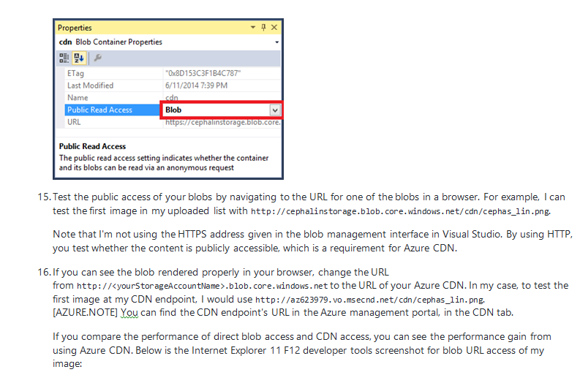
Serve Content from Azure CDN in Your Web Application

Slide 41
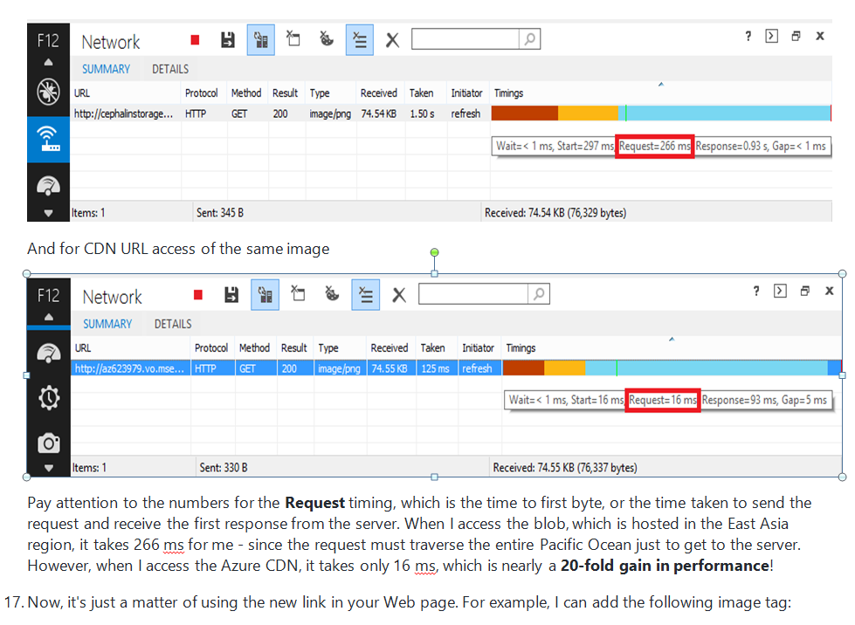
Serve Content from Azure CDN in Your Web Application

Slide 42
Serve Content from Azure CDN in Your Web Application
18. <img alt="Mugshot" src="http://az623979.vo.msecnd.net/cdn/cephas_lin.png" />
In this section, you have learned how to create a CDN endpoint, upload content to it, and link to CDN contentfrom any Web page.

Slide 43
Azure Athentication and it’s methods
Authentication methods are the ways that users authenticate in Azure Active Directory (AD). Authentication methods in Azure AD include password and phone (for example, SMS and voice calls), which are manageable in Microsoft Graph beta endpoint today, among many others such as FIDO2 security keys and the Microsoft Authenticator app. Authentication methods are used in primary, second-factor, and step-up authentication, and also in the self-service password reset (SSPR) process.
The authentication method APIs are used to manage a user's authentication methods. For example:
You can retrieve details of a user's FIDO2 Security Key, and delete it if the user has lost the key.
You can retrieve details of a user's Microsoft Authenticator registration, and delete it if the user has lost the phone.
Authentication method | Description | Examples
fido2AuthenticationMethod | A FIDO2 Security Key can be used by a user to sign-in to Azure AD. | Delete a lost FIDO2 Security Key.
microsoftAuthenticatorAuthenticationMethod | Microsoft Authenticator can be used by a user to sign-in or perform multi-factor authentication to Azure AD | Delete a Microsoft Authenticator authentication method.
temporaryAccessPassAuthenticationMethod | A time-limited passcode that serves as a strong credential and allows onboarding of passwordless credentials.
windowsHelloForBusinessAuthenticationMethod | Windows Hello for Business is a passwordless sign-in method on Windows devices. | See devices where a user has enabled Windows Hello for Business sign-in. Delete a Windows Hello for Business credential.

Slide 44
Azure Athentication and it’s methods
The following authentication methods are not yet supported in Microsoft Graph v1.0.
Authentication method | Description | Examples
Password | A password is currently the default primary authentication method in Azure AD. | Reset a user's password.
phoneAuthenticationMethod (not yet supported) | A phone can be used by a user to authenticate using SMS or voice calls (as allowed by policy). | See a user's authentication phone numbers. Add, update, or remove a phone number to a user. Enable or disable a primary mobile phone for SMS sign-in.
Email | An email address can be user by a user as part of the Self-Service Password Reset (SSPR) process. | See a user's authentication email address. Add, update, or remove an email address to a user.
Hardware token | Allow users to perform multifactor authentication using a physical device that provides a one-time code. | Get a hardware token assigned to a user.
Software token | Allow users to perform multifactor authentication using an application that supports the OAUTH specification and provides a one-time code. | Get and delete a software token assigned to a user.
Security questions and answers | Allow users to validate their identity when performing a self-service password reset. | Delete a security question a user registered.
Default method | Represents the method the user has selected as default for performing multi-factor authentication. | Change a user's default MFA method. NOTE: Managing the details of the default method is currently supported only through the MSOL Get-MsolUser and Set-MsolUser cmdlets, using the StrongAuthenticationMethods property.
Require re-register MFA | Represents a configuration that requires that when user signs in next time, they're requested to set up a new MFA authentication method. | Allow the user to set up new MFA methods, for example, if they changed their authentication device. NOTE: This feature is currently supported only through the MSOLSet-MsolUser cmdlet, using the StrongAuthenticationMethods property.

Slide 45
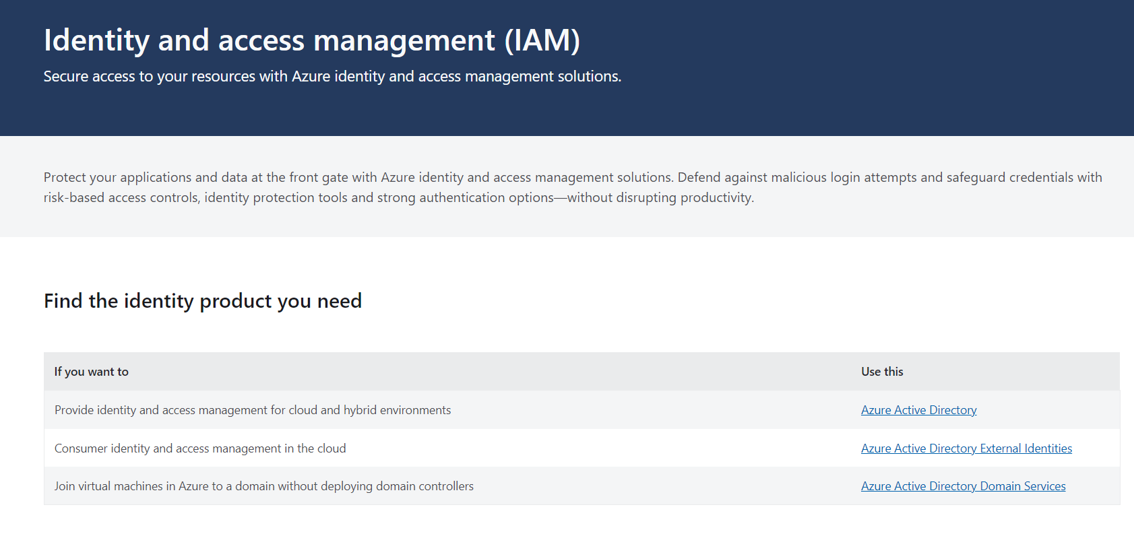

Slide 46
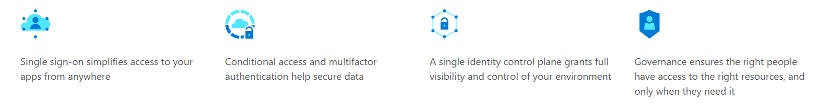
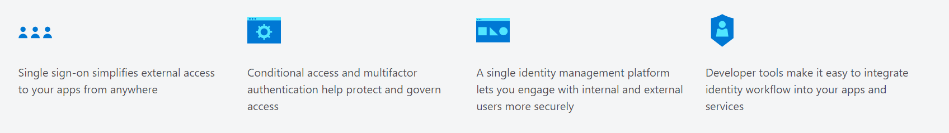
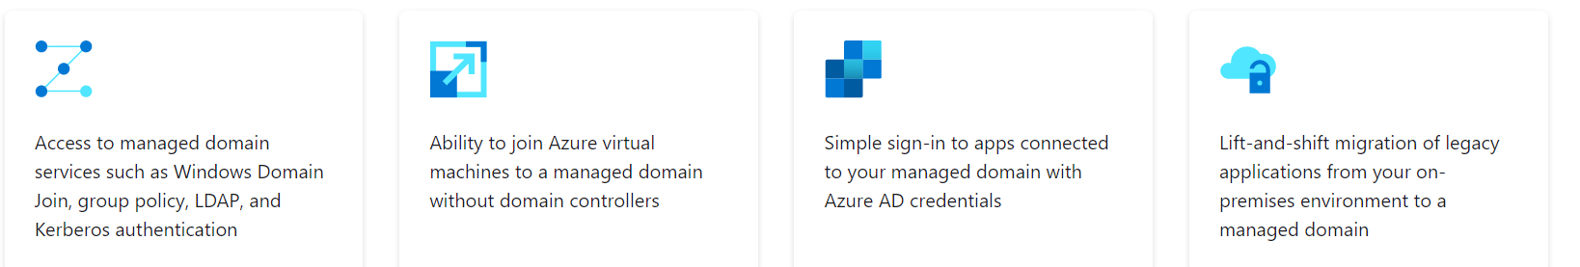

Slide 47
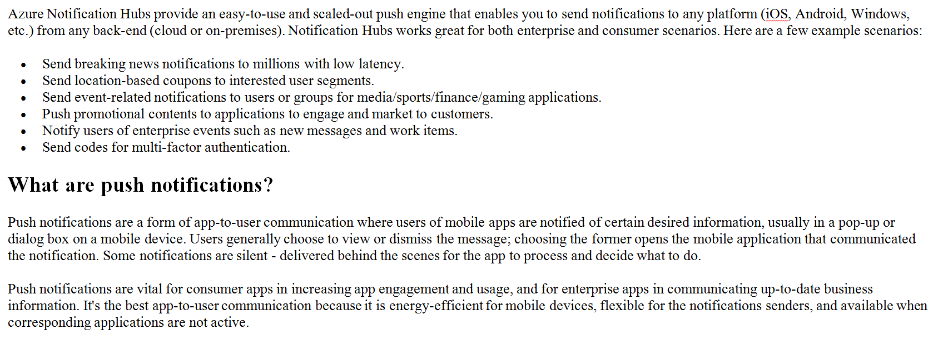
Azure Notification Hubs

Slide 48
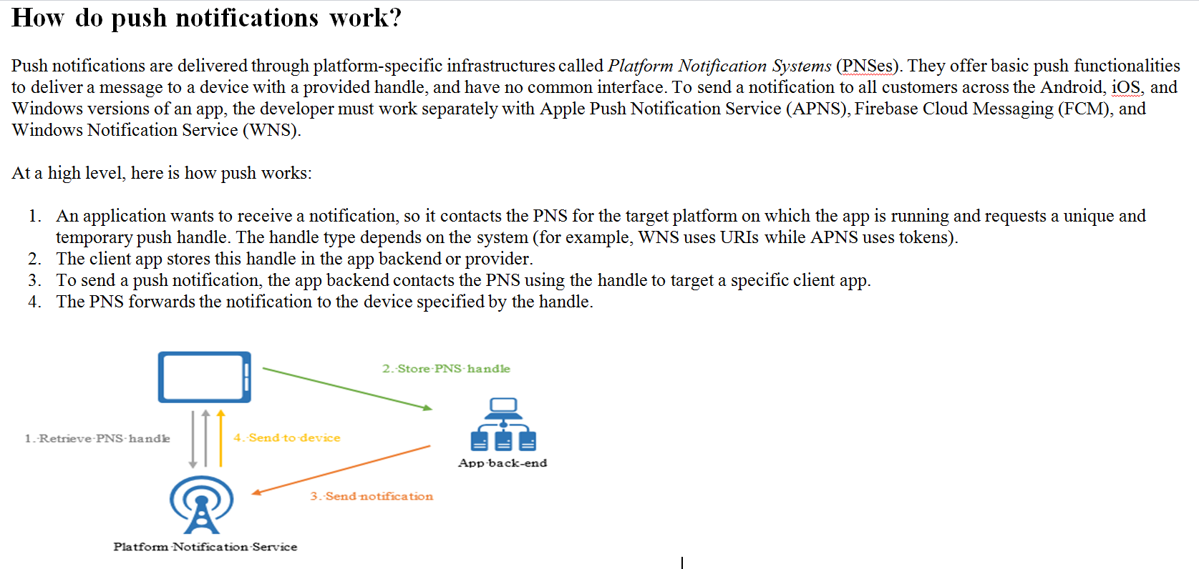
Azure Notification Hubs

Slide 49
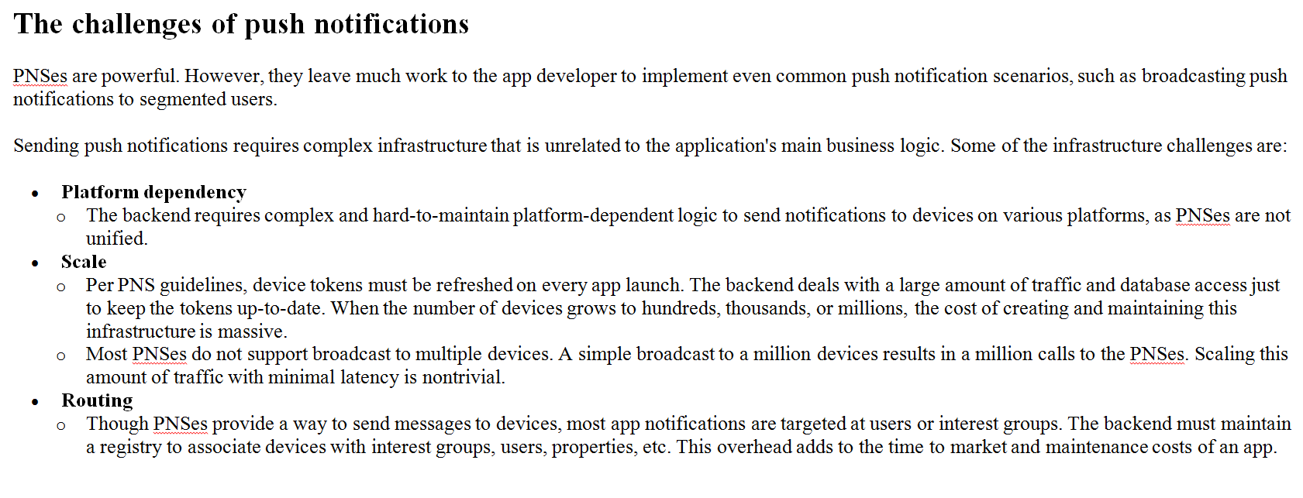
Azure Notification Hubs

Slide 50
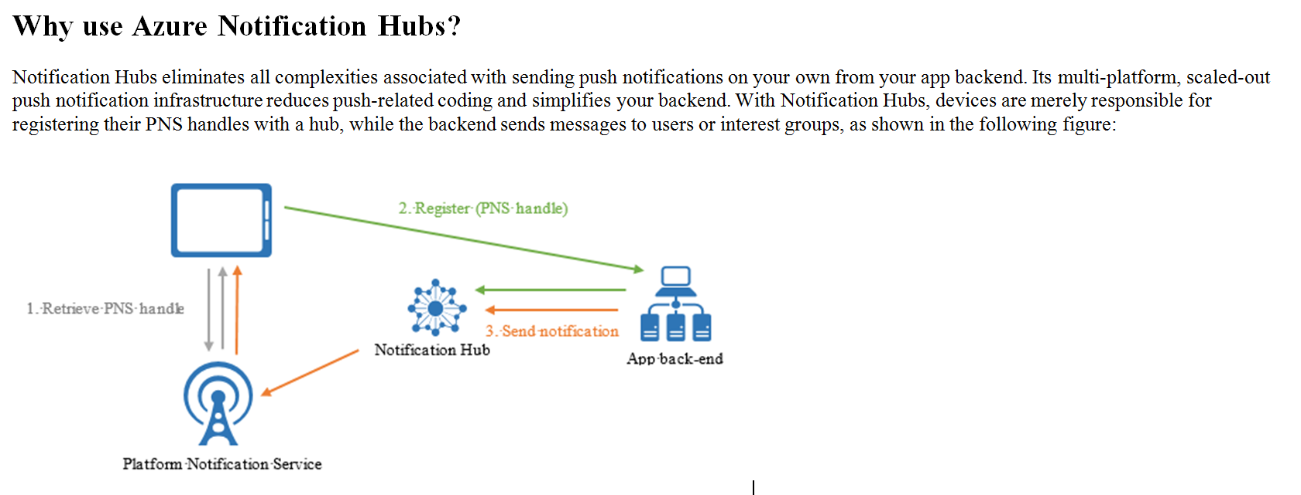
Azure Notification Hubs

Slide 51
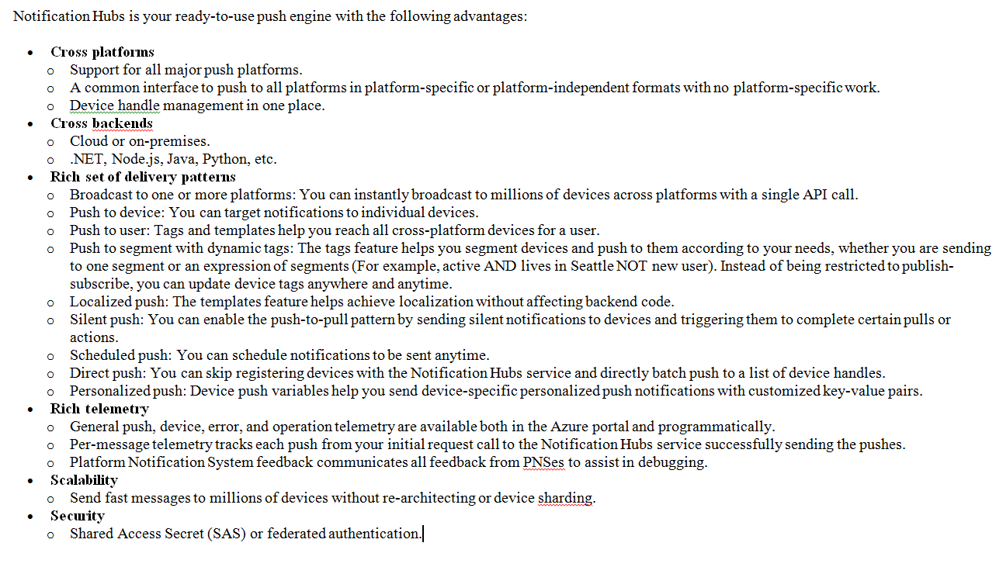
Azure Notification Hubs

Slide 52
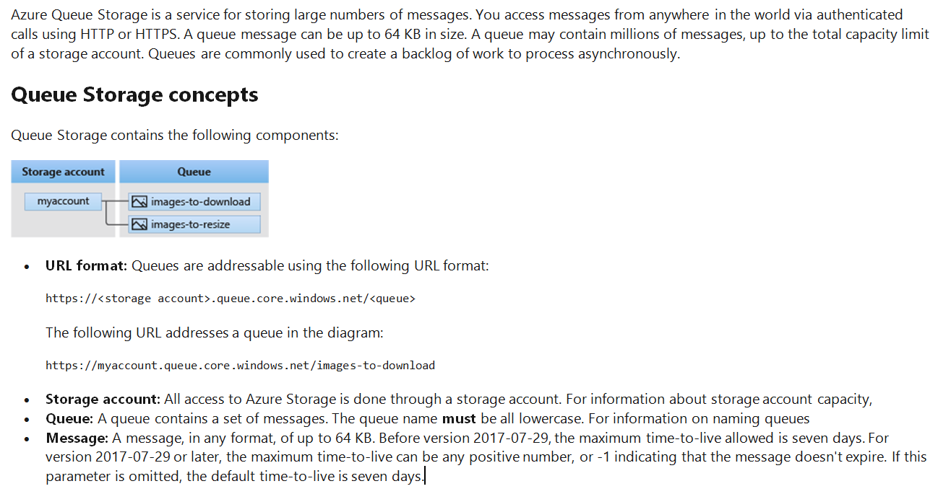
Azure Queue Service

Slide 53
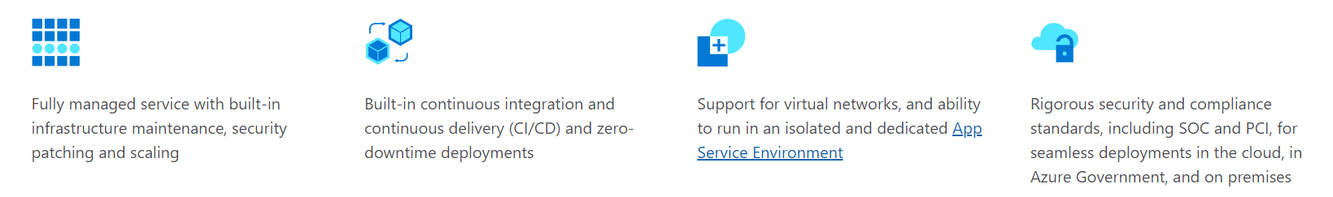
Azure App Service
Azure App Service lets you create apps faster with a one-of-a kind cloud service to quickly and easily create enterprise-ready web and mobile apps for any platform or device and deploy them on a scalable and reliable cloud infrastructure.

Slide 54
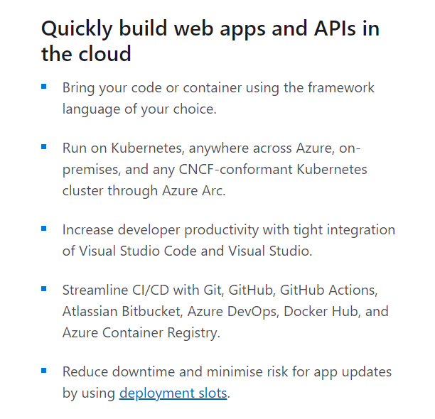
Azure App Service

